Slide 1


Slide 2

Detection of cardio Vesicular diseases using Electro Cardiogram
Presented By
Arslan Shafique Fawad Javed Wahab Haseeb Bhatti
S-49012 S-49015 S-49052
Supervised By
Engr. Sadaf Khan Gondal

Slide 3
outline
  Introduction
  Problem Statement
  Block Diagram
  Signal acquisition
  Preprocessing
  Feature Computation
  Output
  Model analysis
  Activation Function
  Calculating loss
  Parameters
  Evaluation techniques
  Summery

Slide 4
Introduction
Cardiovascular disease generally refers to conditions that involve narrowed or blocked blood vessels that can lead to a heart attack, chest pain (angina) or stroke.
ECG is non-invasive way to detect Cardiac Arrithymias to prevent myocardial infarction.

Slide 5
Electro Cardiogram (ECG)
Atrial and ventricular Fibrillation are represented on the ECG as a series of waves.
ECG Signal has Intervals of Features with different Amplitude and width represented by following
  P wave
  QRS complex
  ST Segment
  T wave
  PR Interval
  QT interval

Slide 6
Problem Statement
“To propose a system that will detect Cardio vascular diseases atrial fibrillation and ventricular fibrillation using Electro cardiogram of cardiac muscle ”

Slide 7
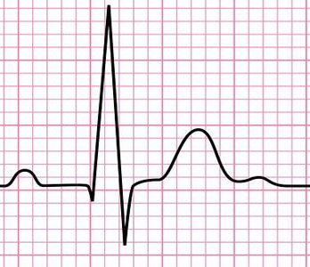
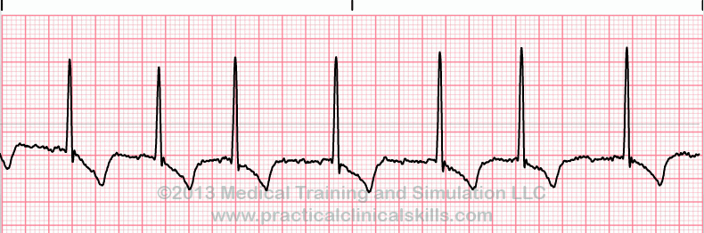
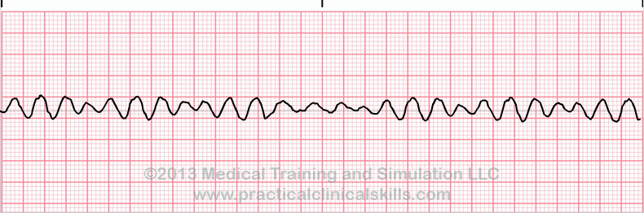
Diseases ECG Variation
Normal ECG
Atrial fibrillation
Ventricular fibrillation

Slide 8
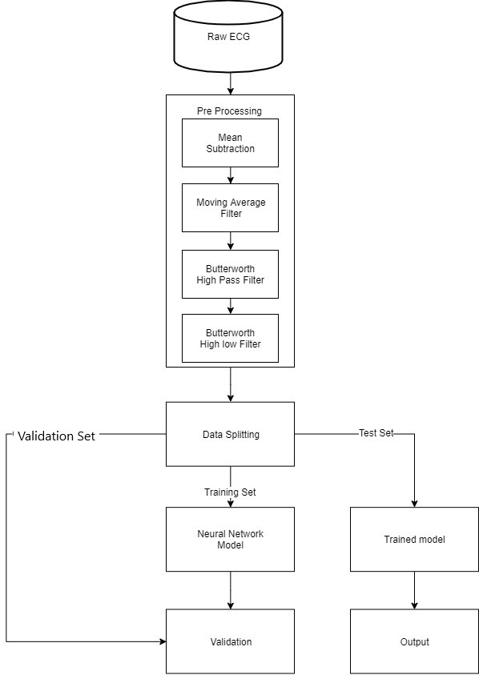
Block Diagram

Slide 9
ECG noise sources
Mainly the noise in the ECG is caused by the following :
Electromagnetic intervention by power line, Electromagnetic field.
The Electromyogram (EMG) noise is generated from electrical activity of the muscle.
Baseline wander is a low-frequency noise component which is mainly due to respiration, and body movement.
Motion artifacts caused by changes electrode motion.

Slide 10

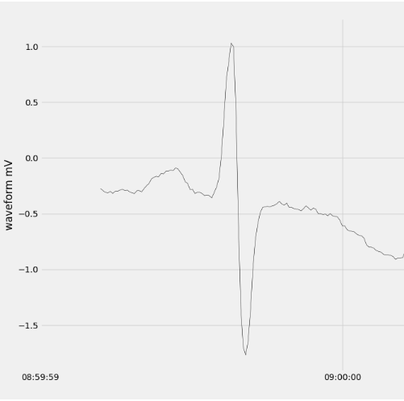
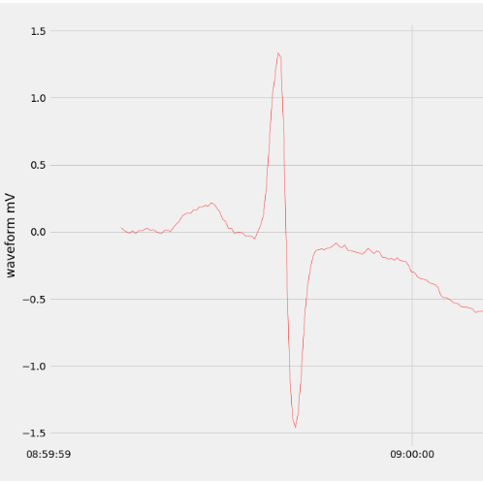
First of all the mean value is subtracted from the signal thus making the mean zero
Noisy Signal After Applying MA filter

Slide 11
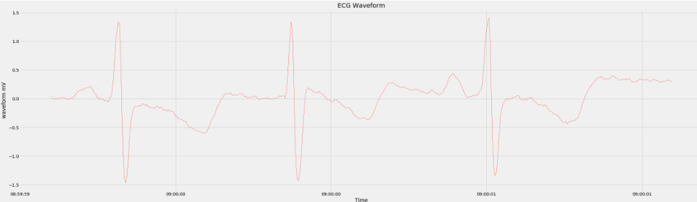
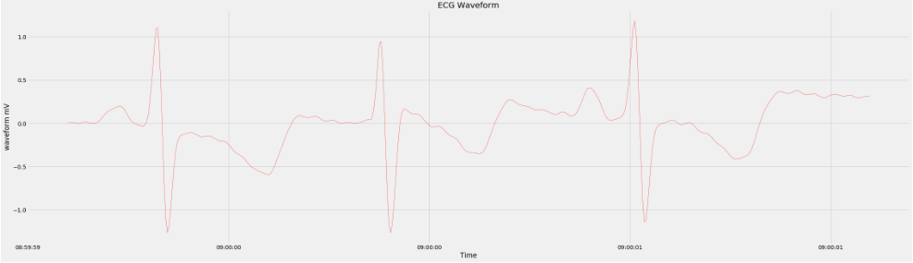
A moving average filter is applied to the signal which is a very simple low pass FIR filter which is used for smoothing the signal
        Fig#1: Before applying Moving Average Filter
        Fig#2: After Applying MA filter

Slide 12
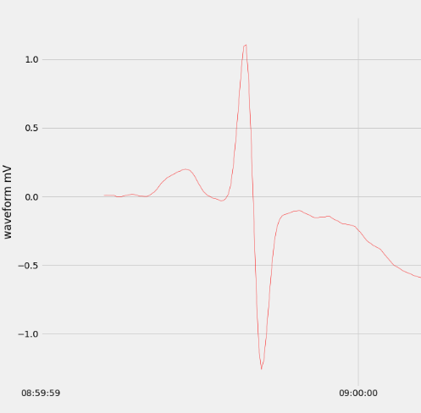
A moving average filter is applied to the signal which is a very simple low pass FIR filter which is used for smoothing the signal
Before applying Moving Average Filter After Applying MA filter

Slide 13
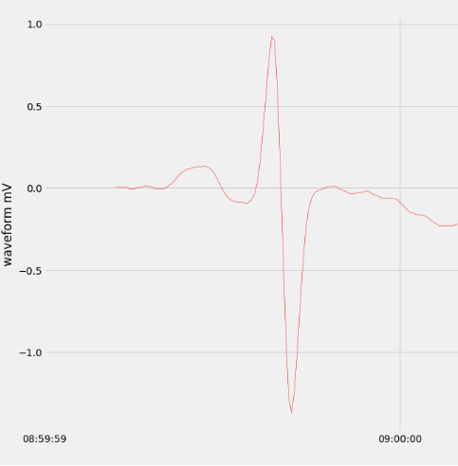
Preprocessing
we have applied a butterworth high pass filter with the cutoff frequency of 1 Hertz the signal.
Before Applying filter After Applying Butterworth Filter

Slide 14
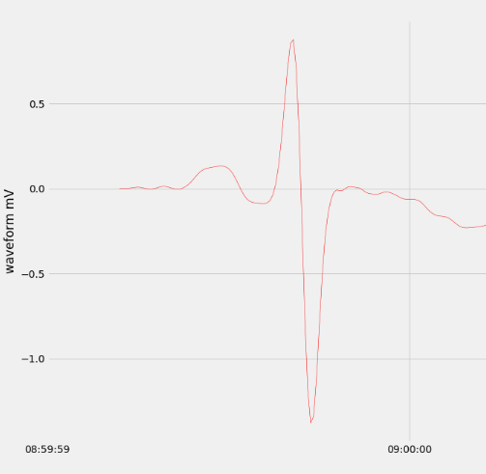
preprocessing
we have applied a butterworth Low pass filter with the cutoff frequency of 1 Hertz the signal.
Before Applying filter After Applying Butterworth Filter

Slide 15
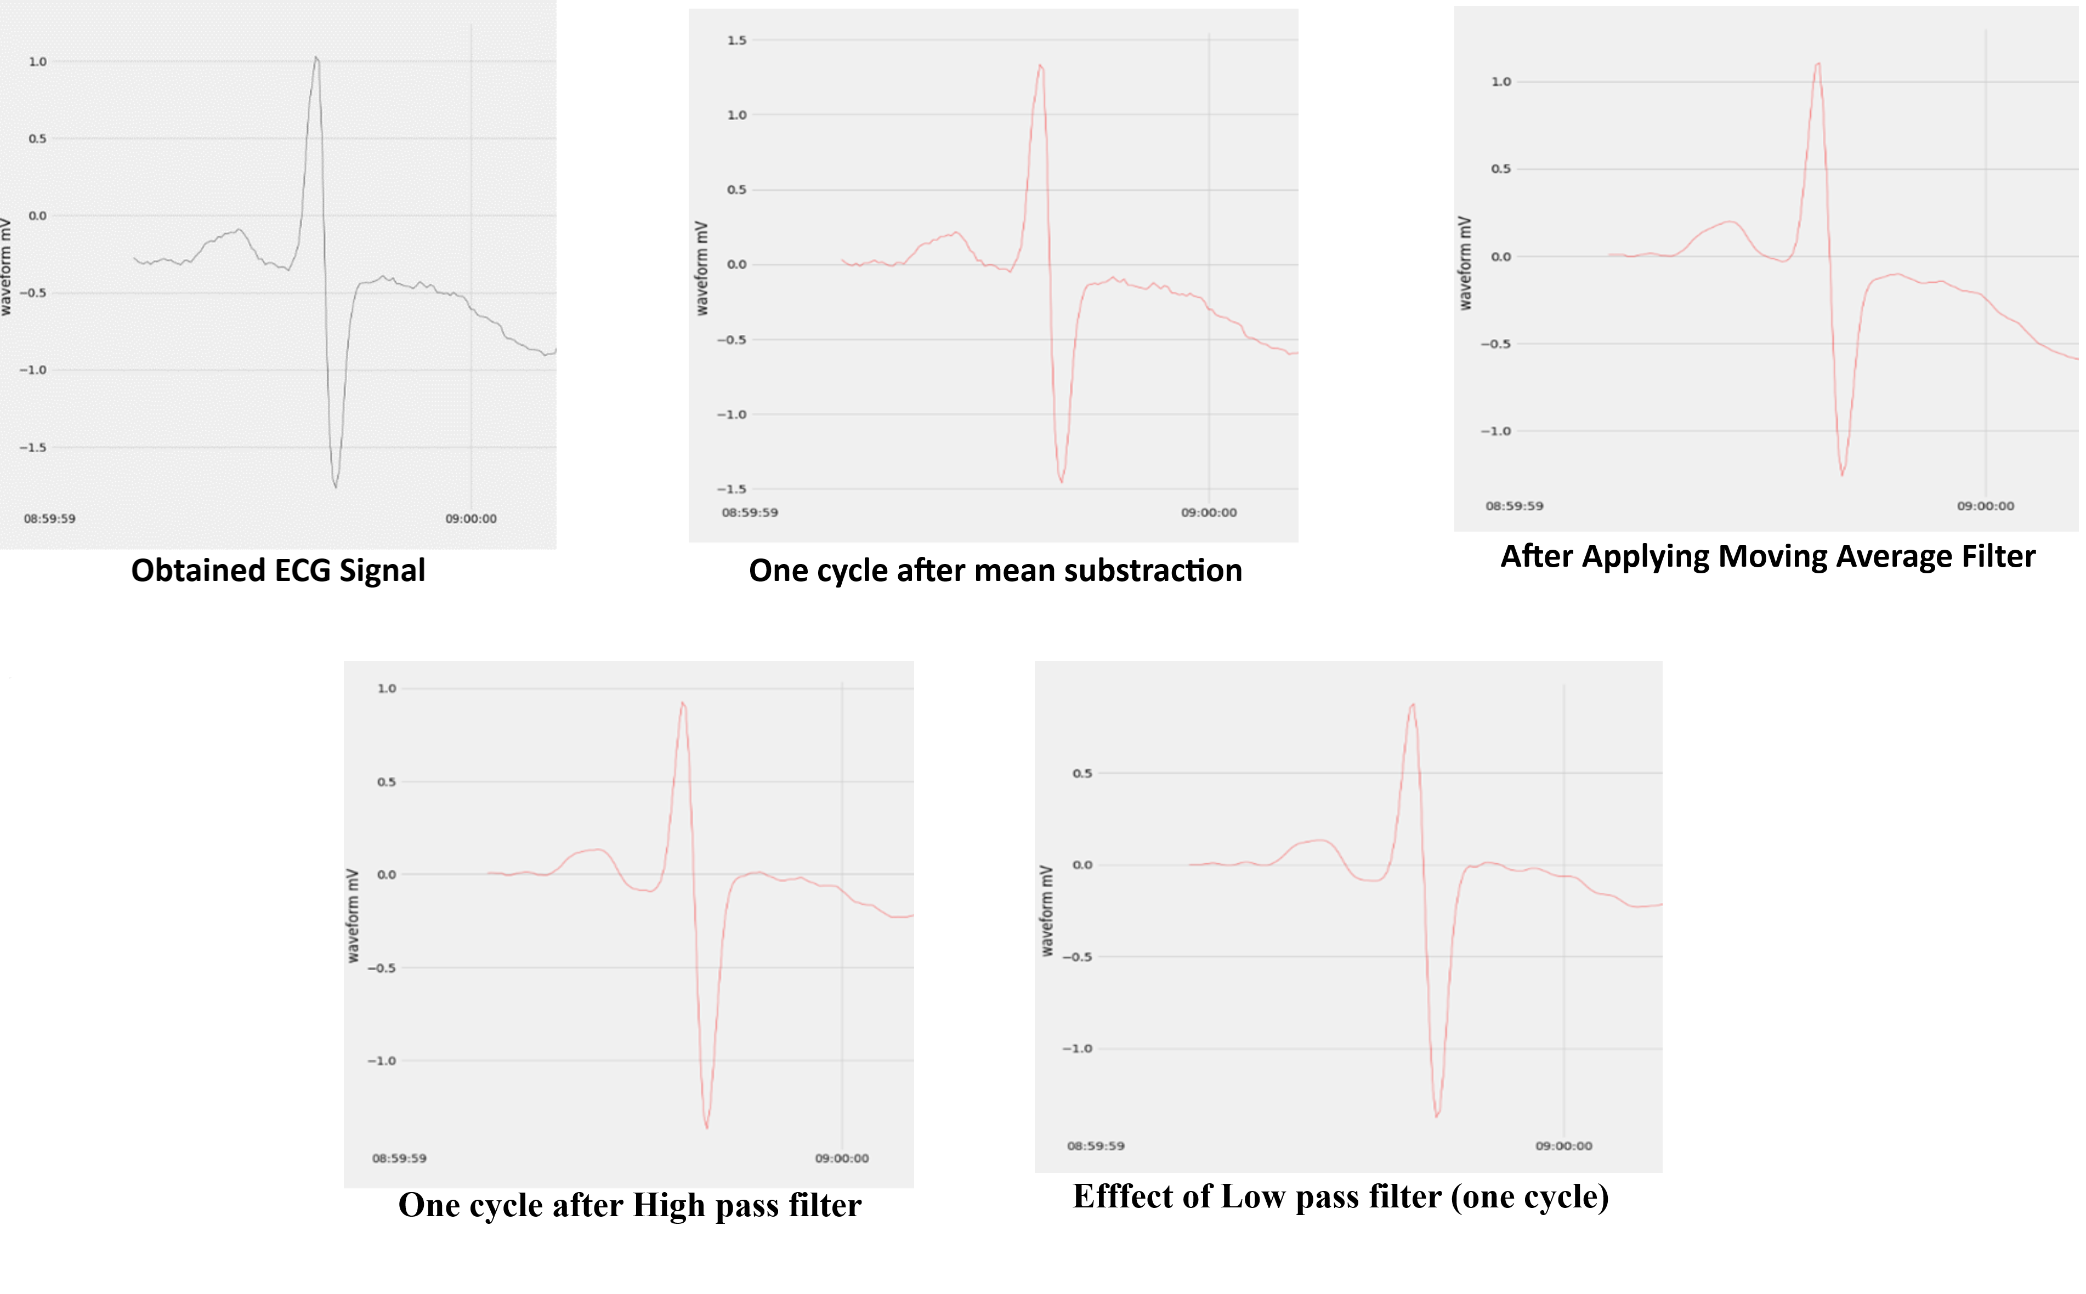
Preprocessing

Slide 16
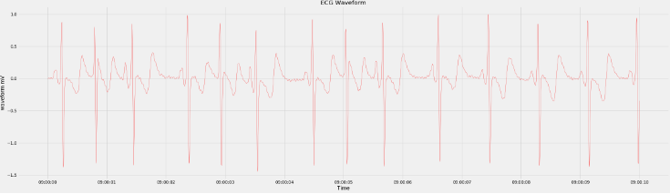
preprocessing
Final ECG after applying filters

Slide 17
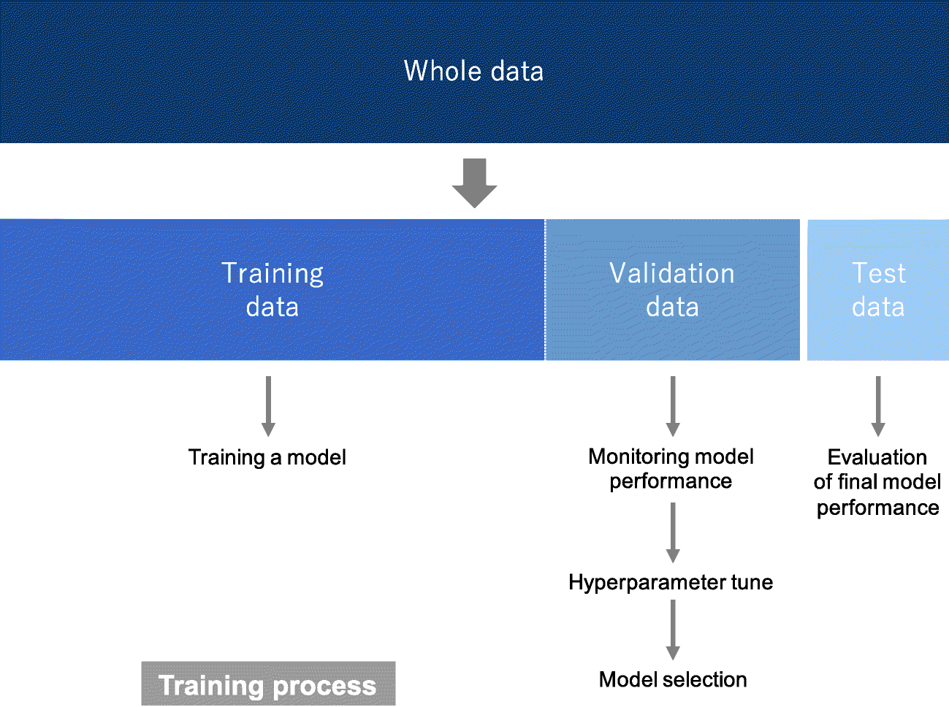

Slide 18
Feature Computation
ECG signal is a complex data.
Number of input nodes/neurons are the initial features that NN gets.
We let Neural Network to learn features from the input signal.

Slide 19
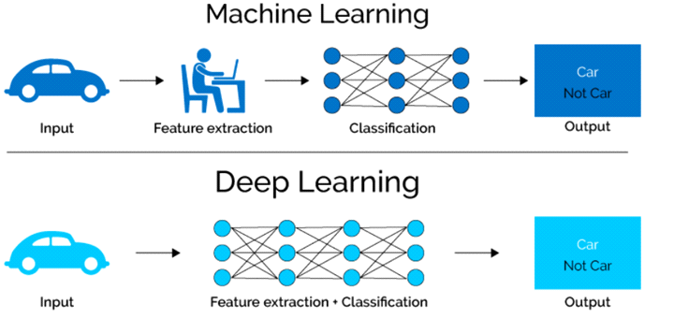
Feature computation

Slide 20
Output
43,500 total number of examples.
30,450 training examples.
Validated across 6,525 examples.
Accuracy on training set is 0.9999343185550083
Accuracy on validation set is 0.9975478927203065

Slide 21
Model Analysis
Deep Neural Network was used
Four layers including input and output layers.
Total number of trainable parameter in our Neural Network are 363,203.

Slide 22
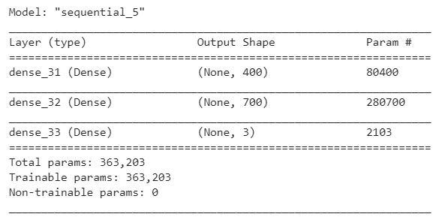
Model Analysis

Slide 23
Parameters
Parameters
Trainable Parameters | 363,203

Slide 24
Hyper-parameters
Hyper-parameters
No. of Layers | 3
No. of Neurons | 400, 700, 3
Activation Function (intermediate layers) | ReLU
Activation Function (output layer) | Softmax
Epochs | More than 2000
Learning Rate | 0.0001
Optimizer | Adam
Loss calculation | Categorical Cross-entropy

Slide 25
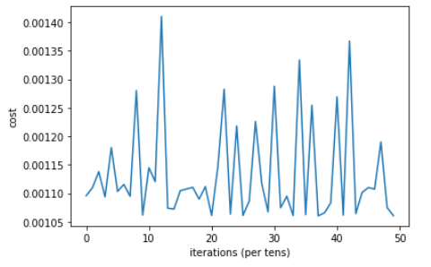
  Statistical and Graphical Analysis
Visual representation of decrease in loss.

Slide 26
Evaluation Technique
Accuracy Score.
Classification Report.
Confusion Matrix.

Slide 27
Evaluation Technique
Accuracy Score.
Accuracy Score: 0.9969348659003832

Slide 28
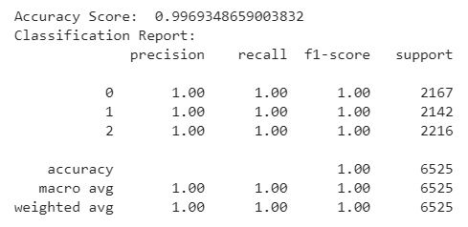
Evaluation Technique
Classification Report.

Slide 29
Evaluation Technique
Confusion Matrix.
Creates a matrix of N x N dimensions
6,505 examples were predicted accurately.
20 examples were predicted wrong
Only 0.3% chance of error.

Slide 30
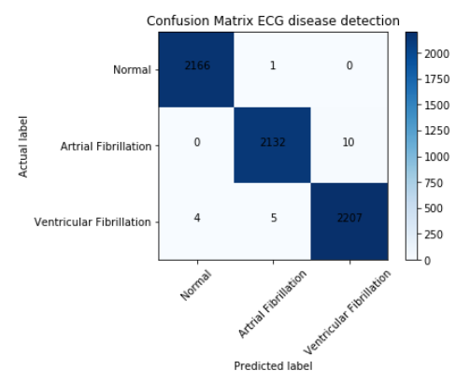
Evaluation Technique

Slide 31
Summary
Developed a Neural Network which consists of four layers
200 input, 400 neurons at l1, 700 neurons at l2 and 3 neurons l3/output layer.
ReLU and Softmax activation function and Adam optimizer were used.
Acquire accuracy was 99%.
For testing functions accuracy score, classification report was used.
Technique confusion matrix to evaluate our model.
acquired 100% precision out of 6,525 examples 6,505 were predicted accurately.

